Slide 1
Prof. Joseph daniel SMBS VIT UNiversity
Thermodynamic Property

Slide 2
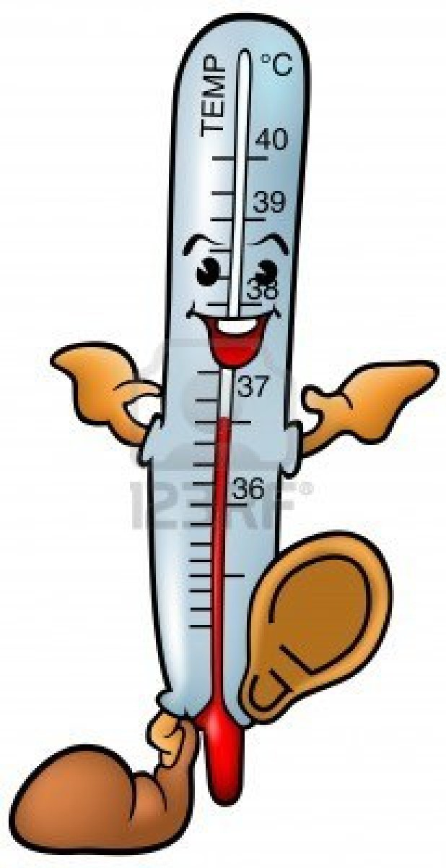
Characteristics that are used to describe the condition or state of a system.
Salient aspects are:
Measurable characteristic describing a system and helps to distinguish one system from another.
Has a definite unique value.
Essentially depends on the state of the system and not on the path or route it takes.
It is also called as point or state function.
Eg: Pressure, Volume, Temperature, viscosity, thermal expansion, electrical resistivity etc.

Slide 3
Property: Any characteristic of a system.
Some familiar properties are pressure P, temperature T, volume V, and mass m. Properties are considered to be either intensive or extensive.
Intensive properties: Those that are independent of the mass of a system, such as temperature, pressure, and density.
Extensive properties: Those whose values depend on the size—or extent—of the system.
Specific properties: Extensive properties per unit mass.

Slide 4
How to denote: Upper case letters for extensive properties and lower case letters for intensive property (P,T are exceptions)
Extensive properties per unit mass are specific properties Eg: Specific volume.
Ratio of extensive property to mole number is called as Molar property
Eg: Molar volume = Total volume/ mole number.

Slide 5
The Concept of Continuum
What is the density of water in a glass at any point?
What is the density of Gas in a cylinder at any point?

Slide 6
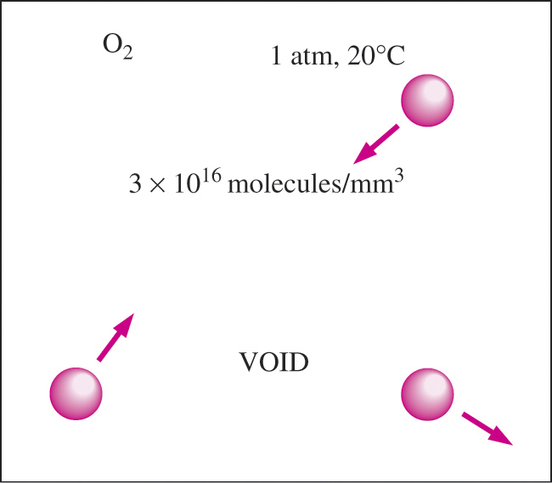
Sure that they are the same.. The reason why?
Even though the atoms in a gaseous state or liquid state are widely spaced the very atomic nature of the substance is disregarded and the substance is viewed as a continuous homogeneous matter without holes between them.
Continuum model is applicable as long as the characteristic length of the system is much larger than the mean free path of the molecules.
For higher mean free paths, rarefied gas theory has to be applied.

Slide 7
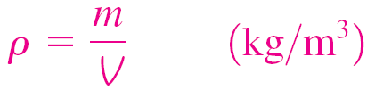
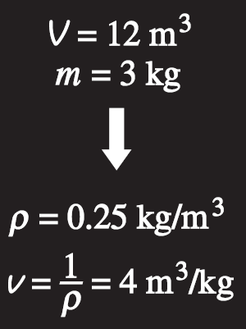

DENSITY AND SPECIFIC GRAVITY
Density
Specific gravity: The ratio of the density of a substance to the density of some standard substance at a specified temperature (usually water at 4°C).
Specific volume
Specific weight: The weight of a unit volume of a substance.
Density is mass per unit volume; specific volume is volume per unit mass.

Slide 8

Equilibrium
Implies a state of balance, there aren’t any unbalanced potential that can act as a change agent.
A system in equilibrium experiences no changes.
Types of Equilibrium:
a) Mechanical Equilibrium- Uniformity in Pressure. Pressure gradients are removed by internal changes.

Slide 9
b) Chemical Equilibrium- Even if mechanical equilibrium is reached spontaneous change of internal structure is possible due chemical reactions. It represents a condition when all chemical reactions ceases and mass diffusion stops.
c) Thermal Equilibrium- Condition or a state when temperature is uniform.
Heat flow from a higher temperature source towards lower temp source occurs till the lower temperature reaches the higher temperature. Both attain the same temperature.

Slide 10
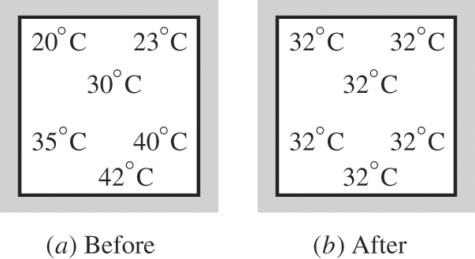
Thermodynamic Equilibrium- A system which is simultaneously in a state of mechanical, thermal or chemical equilibrium.

Slide 11
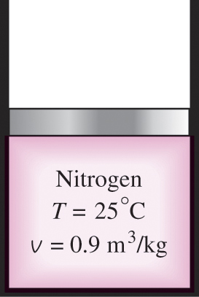
State, Path, Process and Cycle
State Postulate: Number of properties required to fix the state of a system is known as state postulate.
Eg: The state of a simple compressible system is completely specified by 2 independent intensive properties.

Slide 12
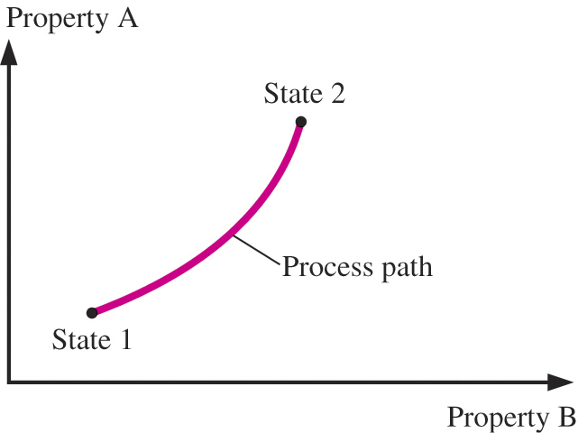
Change of state: Any operation in which the properties of the system changes.
Path: Locus of series of states through which a system passes in going from initial to final state will constitute a path.
Process: A complete specification of a path is known as a process.

Slide 13
Types of Processes
Cyclic Process- When a system in a given state undergoes through a series of processes such that the final state is same as that of the initial state. Then a cycle is said to be executed.
Think it over- Can this thought be applied to a process of an I.C Engine.

Slide 14
Different Processes
The prefix iso- is often used to designate a process for which a particular property remains constant.
Isothermal process: A process during which the temperature T remains constant.
Isobaric process: A process during which the pressure P remains constant.
Isochoric (or isometric) process: A process during which the specific volume v remains constant.
Cycle: A process during which the initial and final states are identical.

Slide 15
What promotes the change of states during a thermodynamic process?

Slide 16
It is due to the unbalanced potential that exists in a system to cause or promote a change
Piston and Weights: In a gas filled piston and cylinder arrangement, the upward force exerted by the gas is balanced by the downward force exerted by the weights.
If the weights are removed in succession the unbalanced potential is infinitesimally be small.
The piston is slowly moved upwards.

Slide 17
The departure of the state of system from the thermodynamic equilibrium state will be infinitesimally small.
The locus of series of such equilibrium states is called as quasi static or quasi equilibrium process.
Think it over: Is this Quasi static process a fast or slow process? What will happen if all the weights are removed suddenly? Can this process be represented in a state diagram?

Slide 18
Reversible and Irreversible Process
Conditions need to be satisfied for a reversible process
1) There shouldn’t be any solid or fluid friction
2) The heat exchange to or from the system is only through infinitely small temperature difference.
3) Should be a quasi static process, should happen in an infinitely slow speed, pressure difference between the system and surroundings must be infinitely be small

Slide 19
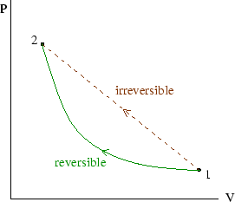
Salient Features of Reversible Process
Can be carried out in the reverse direction along the same path
Leaves no trace of its occurrence, no after effects or traces left
It can proceed in both the directions
Results in maximum efficiency without wastages
Yields maximum work in engines and requires minimum work in devices like refrigerators.
Degree of reversibility can be considered as a measure of perfection
Work done during a reversible process is represented by area under the process line

Slide 20
Examples
Restricted or controlled expansion or compression
Motion without friction
Isothermal and frictionless adiabatic process
Elastic stretching of solid
Electric circuit with zero resistance
Restrained discharge of battery

Slide 21
Irreversible process
A process is irreversible if it passes through a sequence of non equilibrium states
The properties of the system do not have a unique value and hence cannot be located in a property diagram.
When allowed to proceed in the backward direction, the original state of the system is not restored.

Slide 22
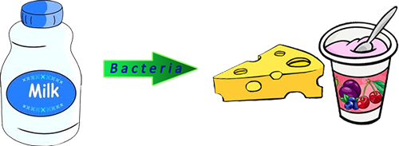
Salient features of Irreversible process
It can be carried out in one direction only
It occurs at a finite rate
Cannot be reversed without causing permanent changes to the environment
Never be in equilibrium during the irreversible process.

Slide 23

Can you define these basic terms
Mass
Force
Weight
Specific Weight
Density
Specific volume
Energy

Slide 24
Mass – Quantitative measure of an objects resistance to acceleration
Force - a force is any influence that causes an object to undergo a certain change, either concerning its movement, direction, or geometrical construction (N)
Weight – Force on the object due to gravity (mg)
Specific Weight – Weight per unit volume (N/m³)
Density – amount of working substance contained in a given volume (kg/m³)
Specific volume – Volume per unit mass (m³/kg)

Slide 25
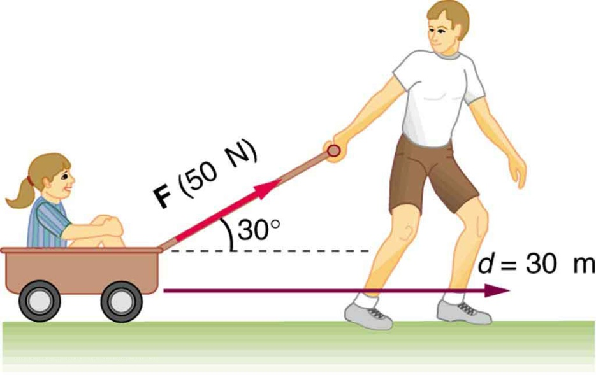
Work and Energy
Work: is done when point of application of force moves in the direction of the force.
It equals the products of force and displacement in the direction of the force
Work done = Force*distance
Energy: is the capacity to produce a change from the existing conditions.

Slide 26
Energy can take a form of
Stored Energy- Energy contained within the system boundaries
Eg: Kinetic Energy, potential energy and internal energy
Energy in transit- Energy that crosses the boundaries
Eg: Kinetic energy, mechanical energy and electrical energy.

Slide 27
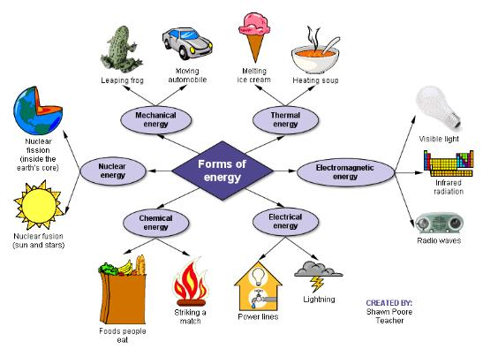
Forms of Energy

Slide 28
Do you know what is the industrial unit of energy?
General unit of energy is known in joules (J) or kilo joules (kJ)
1 Watt is 1 J/s
Power is the rate of work or energy transfer.

Slide 29
Some useful conversions
1 Btu = 1055 J
1 Cal = 4.18 J
1 N.m = 1 J
1 t coe = 29 307 600 000 Joule
1 toe = 41 868 000 000 Joule
1 Watt hour = 3600 Joule
1 kilowatt hour = 860 050.647 43 calorie [15° C]
1 electronvolt = 1.6021773e⁻¹⁹ joule

Slide 30
Potential and Kinetic Energies
Potential energy:
is the energy possessed by a system due to its position or elevation.
ability to do work against the body weight in lifting it from the surface of the earth
P.E= Weight x head raised
= mg x z
When is P.E = 0

Slide 31
Kinetic energy
is the energy possessed by a system by virtue of its motion.
K.E= ½ x mV²
Both P.E and K.E are external forces of energy due to the fact that they are not dependent upon the system composition.
Mechanical Energy = P.E+K.E

